Slide 1
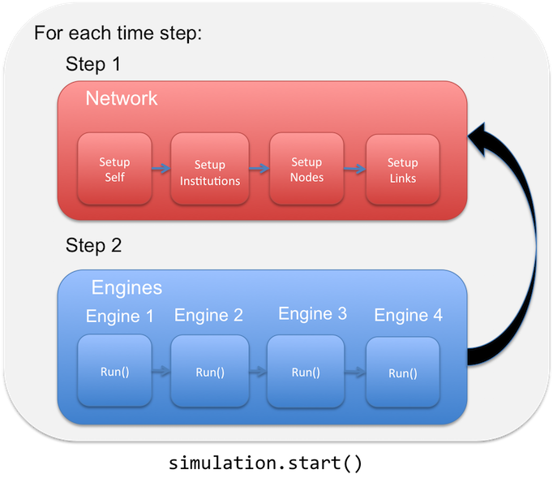
Model Sequence
Simulation setup
Add engines to simulation
Start simulation

Slide 2
Simulation Setup
s = ICOMSimulator() - Create pynsim simulation object, s
s.set_timestep_information() – Add timesteps to simulation, s.timesteps
s.set_landscape() – Add landscape/network to simulation, s.network
s.network.add_institution(CountyZoningManager(name='005’)) – Add example zoning agent, s.network.get_institution(‘005’)
s.network.add_institution(AllHHAgents(name='all_hh_agents’)) – Add categorical institution that contains all household agents, s.network.get_institution(‘all_hh_agents’)
s.convert_initial_population_to_agents() – Convert initial population to household agents, s.network.get_institution(‘all_hh_agents’).components

Slide 3
Add Engines to Simulation:
s.add_engine(NewAgentCreation()) - Creates new household agents based on population growth assumptions and adds them to the unassigned queue, s.network.unassigned_hhs
s.add_engine(ExistingAgentReloSampler()) – Identifies existing household agents that want to re-location and adds them to the relocating queue, s.network.relocating_hhs
s.add_engine(HousingInventory()) – Determines the housing inventory available for each block group, s.network.available_units_list
s.add_engine(NewAgentLocation()) – For each agent in s.network.unassigned_hhs sample 10 available properties and calculate utility, example_hh_agent.hh_utilities
s.add_engine(ExistingAgentLocation()) – For each agent in s.network.relocating_hhs sample 10 available properties and calculate utility, example_hh_agent.hh_utilities
s.add_engine(HousingMarket()) – Matches agents in s.network.unassigned_hhs and s.network.relocating_hhs with top properties.
TBD Engines:
s.add_engine(RealEstate())
s.add_engine(FloodHazard())
s.add_engine(Zoning())

